Slide 1
PRHS
Career & Technical Education Department
Rising 9th Grade Presentation

Slide 2
Why Take CTE Classes?
Choose classes based on career interests
Relevant curriculum for real-world application
Prepares students to be ready for college and career-ready
Apply knowledge in a CTSO
Meet people with common interests
Earn certifications
Integrates employability skills
Hands-on learning

Slide 3
What is a Career Pathway?
Concentration of classes with common features within an industry
Sequence of 3 classes
Intro / Prerequisite Course
2nd Level Course
3rd Level Course

Slide 4
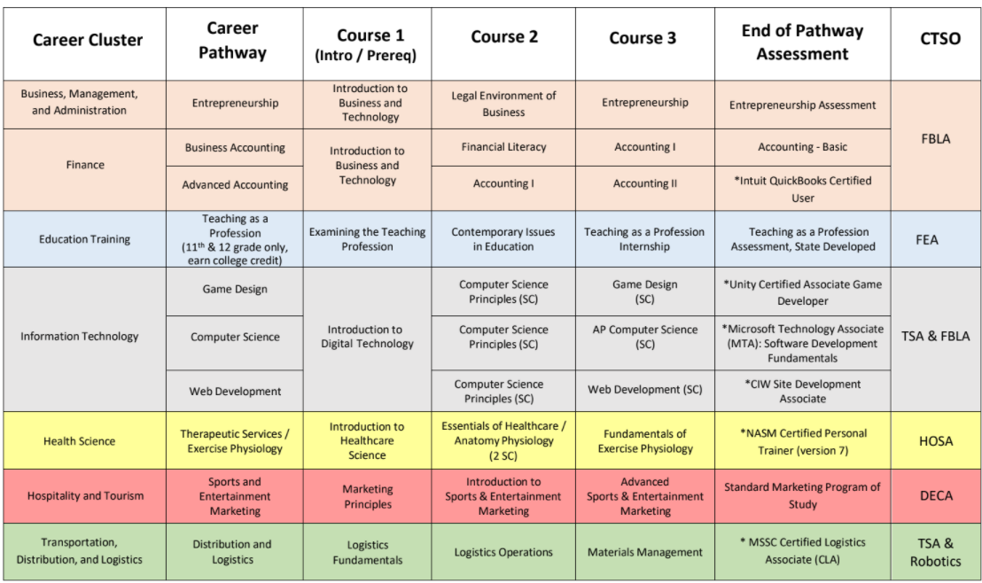
What Pathways are Available at PRHS?

Slide 5
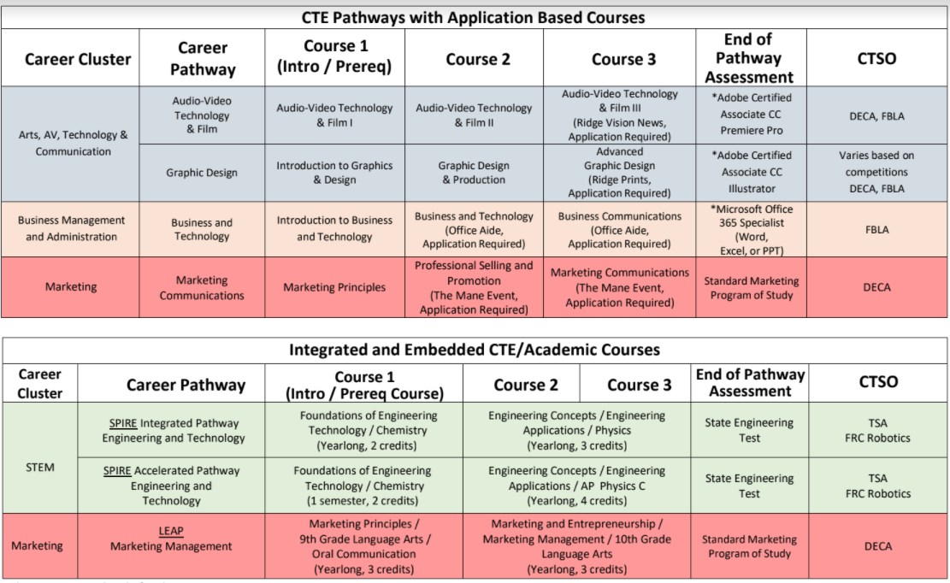
Pathways at PRHS

Slide 6
What is an End of Pathway Assessment (EOPA)?
An industry recognized test which demonstrates student’s content knowledge
Earn a diploma seal
Stand out on college applications, job applications, internships, etc.

Slide 7
What Choices Do I Have as a 9th Grader?
Intro to Business and Technology
Intro to Digital Technology
Intro to Healthcare Science
Marketing Principles
Logistics Fundamentals
Audio-Video Technology & Film I
Intro to Graphics & Design
LEAP (Marketing Principles + Language Arts)
SPIRE (Engineering + Science OR Science + LA)
JROTC

Slide 8
What is a Career & Technical Student Organization (CTSO)?
Club related to a career interest
Apply classroom curriculum and practice employability skills
Community service
Competition
Leadership

